Slide 1

Anomaly detection: A survey
Varun chandola, arindam banerjee and vipin kumar
Acm computing surveys, vol. 41, n°3, article 15, publication date: july 2009

Slide 2



THE authors
Varun chandola
University at Buffalo
Arindam banerjee
University of Minnesota
Vipin kumar
University of Minnesota

Slide 3
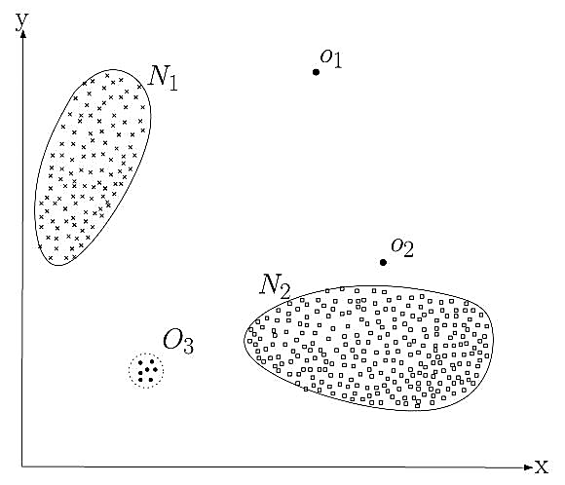
Introduction
Anomaly detection refers to the problem of finding patterns in data that do not conform to expected behavior (anomalies, outliers, exception, peculiarities, ecc.).
Wide variety of applications (fraud detection, intrusion detection, fault detection)

Slide 4
Anomaly detection
What is anomaly detection?
Anomalies are patterns in data that do not conform to a well defined notion of normal behavior
Anomalies are interesting to the analyst
Anomaly detection aims finding these patterns
What is not anomaly detection?
Anomaly detection is distinct from noise removal , noise accomodation or novelty detection
Noise can be defined as a phenomenon in data that is not of interest to the analyst but act as a hindrance to data analysis.
Novelty detection aims detecting previously unobserved patterns in data (tipically these patterns are incorporated into the normal model after being detected)
Wide variety of applications (fraud detection, intrusion detection, fault detection)

Slide 5
challenges
Define a region representing a normal behavior and declare any observation in the data that does not belong to this normal region as an anomaly:
Defining a region that encompasses every possible normal behavior is very difficult
Boundary between normal and anomalous behavior is often not precise
Malicious adversaries make the anomalous observations appear normal
Normal behavior can keeps evolving
Exact notion of anomaly is different for different application domains
Availabilty of labelled data
Data contains noise

Slide 6
Nature of input data
Each data instance can be described using a set of attributes
Attributes can be of different types
Univariate/multivariate (in the second case attributes might be a mixture of types)
Sequence data:
Instances are linearly ordered (time-series, genome, ecc.)
Spatial data:
Instances are related to their neighboring instances (vehicular traffic data, ecological, ecc.)
Graph data:
Instances are represented as vertices in a graph connected with other vertices with edges

Slide 7
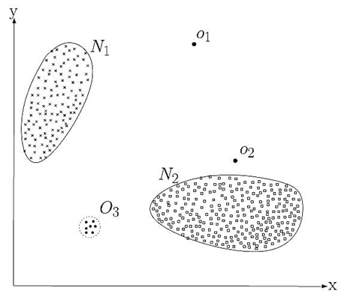
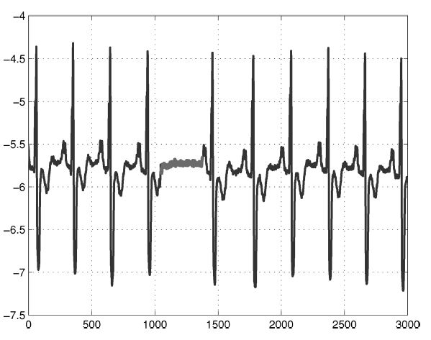
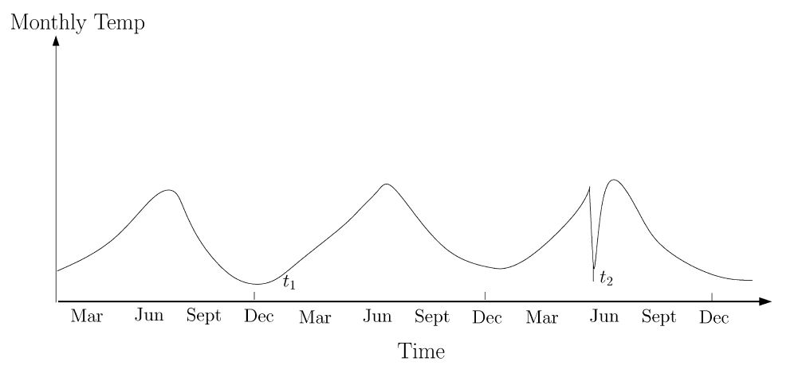
Type of anomaly
Point anomalies
An individual data instance considered as anomalous with respect to the rest of data
Contextual anomalies
A data instance can be anomalous in a specific context but not otherwise
Collective anomalies
A collection of related data instances considered as anomalous with respect to the entire data set

Slide 8
Data labels
The labels associated with a data instance denote wheter that instance is normal or anomalous
Labelling is often done manually by a human expert
Getting a labeled set of anomalous data instances that covers all possible type of anomalous behavior is more difficult than getting labels for normal behaviors
Supervised anomaly detection techniques
Availability of a training data set that has labeled instances for normal as well as anomaly classes
Semisupervised anomaly detection techniques
Training data has labeled instances only for the normal class
Unsupervised anomaly detection techniques
Do not require training data

Slide 9
Output of anomaly detection
Scores
Scoring techniques assign an anomaly score to each instance in the test data depending on the degree to wich that instance is considered anomaly
Ranked list
Labels
Techniques in this category assign a label to each test instance (normal or anomalous)
Binary labels

Slide 10
background
Study of the requirements (computational and memory requirements)
Design hardware and software system
Build an engineering model
Testing to demonstrate the fault-tolerant behavior

Slide 11
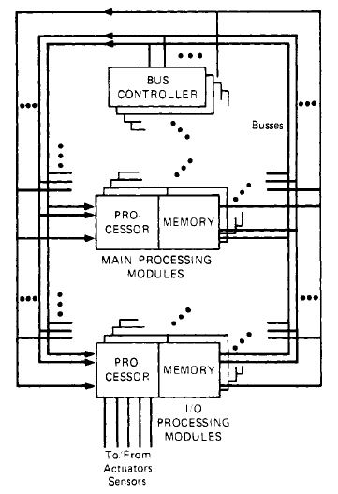
System overview

Slide 12
System overview
The SIFT system executes a set of tasks, each of wich consists of a sequence of iterations
The input data to each iteration of a task is the output data produced by the previous iteration of some collection of tasks (wich may include the task itself)
Each iteration of a task is independently executed by a number of modules
A processor execute the iteration
The processor places the iteration’s output in his memory associated
A processor that uses the output of this iteration determines its value by examining the output generated by each processor wich executed the iteration (typically a «two out of three» votation)

Slide 13
System overview
Iterative nature of the tasks:
economize the amount of voting
voting only at the beginning of each iteration than voting on the results of all calculations
loose synchronization of the different processors
an iteration can be scheduled for execution at slightly different times by different processors
simultaneous transient failures of several processors will be less likely to produce correlated failures in the replicated versions of a task
The number of processors executing a task can vary with the task and can be different for the same task at different times
The allocation of task to modules is determined dinamically by a task called the global executive

Slide 14
Fault isolation
Preventing a faulty unit from causing incorrect behavior in a nonfaulty unit
Protection against the corruption of data is provided by the way in wich units can communicate
A processing module can read data from any processing module’s memory, but it can write only in its own memory
Fault isolation also requires that invalid control signals not produce incorrect behavior
Wrong action
Not providing service to other units
These two type of fault propagation are prevented by making each unit autonomous, with its own control

Slide 15
Fault masking
The processor receive multiple copies of the data
Each copy is obtained from a different memory over a different bus and the processor uses majority voting to obtain a correct version of the data
After identifying the faulty unit, the system will be reconfigured
Faulty processing module ➔ the tasks are reassigned to other modules
Faulty bus ➔ processors will request their data over other buses

Slide 16
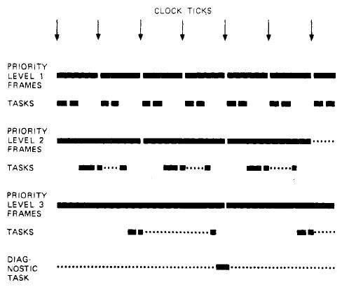
scheduling
Two types of timing requirements
Output to the actuators must be generated with specific frequency
The delay between the reading of sensors and the generation of output to actuators based upon these readings must be kept below specified limits
Iteration rate assigned to each task
The processing of each iteration of the task must be completed within the time frame

Slide 17
Processor synchronization
Needs 3N+1 clocks to mask any N simultaneous fault
Clock synchronization algorithm
Each clock computes a vector of clock values, interactive consistency vector
A clock P set the entry of the vector corresponding to P itself to P’s own value
The value for the entry of another processor q is obtained as follow
Read q’s value from q
Obtain from each other clock r the value of q that r read from q
Majority agree ➔ majority value used, otherwise NIL (q is faulty)
Let δ the maximum amount by wich the values may disagree
Any value greater then δ or NIL is ignored
P takes the median value of the remaining components as its new value

Slide 18
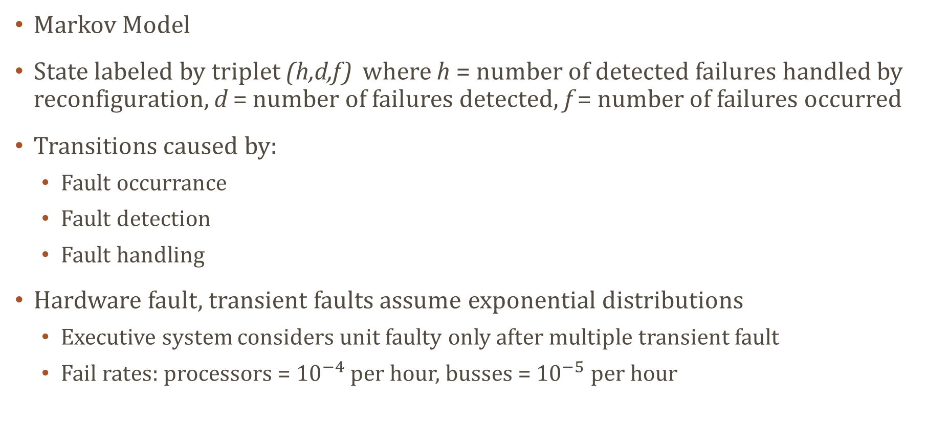
Reliability prediction
Markov Model
State labeled by triplet (h,d,f) where h = number of detected failures handled by reconfiguration, d = number of failures detected, f = number of failures occurred
Transitions caused by:
Fault occurrance
Fault detection
Fault handling
Hardware fault, transient faults assume exponential distributions
Executive system considers unit faulty only after multiple transient fault
Fail rates: processors = ${10}^{−4}$ per hour, busses = ${10}^{−5}$ per hour

Slide 19
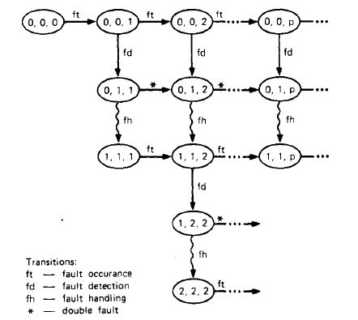
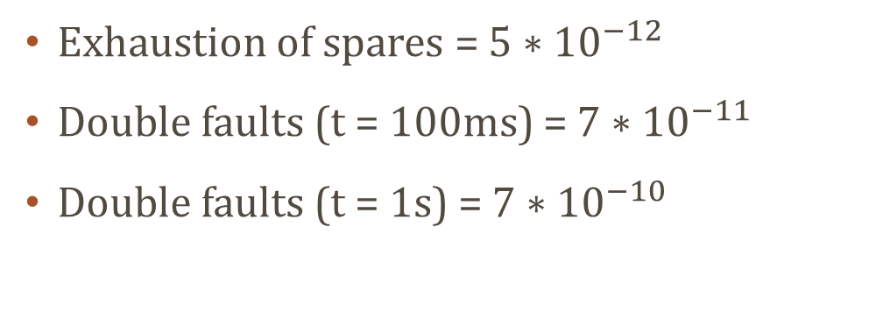
Reliability prediction
Exhaustion of spares = $5∗{10}^{−12}$
Double faults (t = 100ms) = $7∗{10}^{−11}$
Double faults (t = 1s) = $7∗{10}^{−10}$

Slide 20
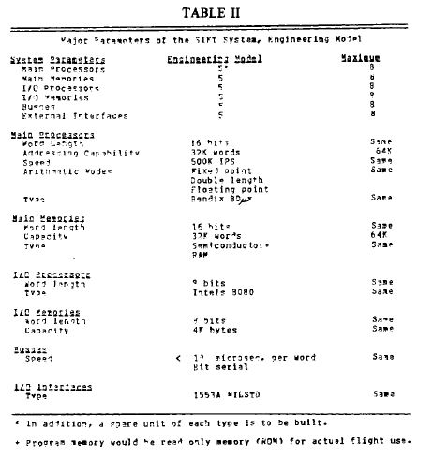
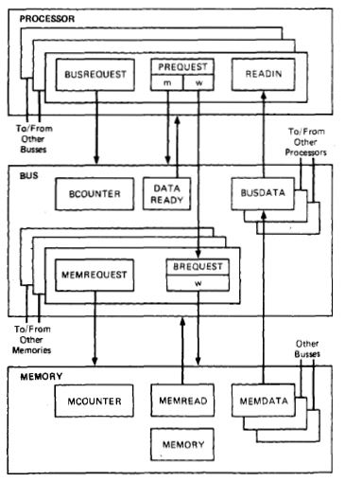
The Sift hardware
SIFT system attempts to use standard units whenever possible
Special design is needed only in the bus system and in the interface between the buses and the processing modules

Slide 21
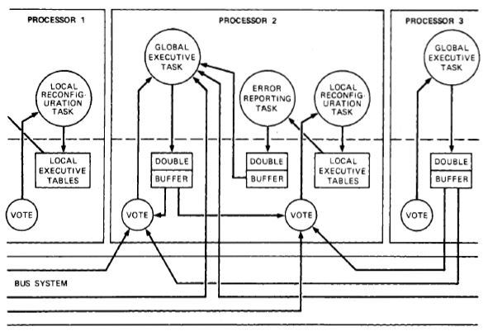
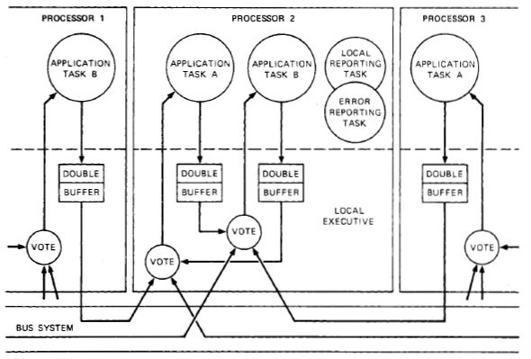
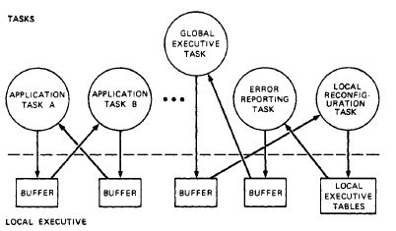
The software system
Executive software
Responsible for the reliable execution of the application tasks
Run each task at the required iteration rate
Provide correct input values
Detect errors, diagnose their cause
Reconfigure system after failure
3 executive components
Global executive task
Local executive
Local-global communication tasks

Slide 22
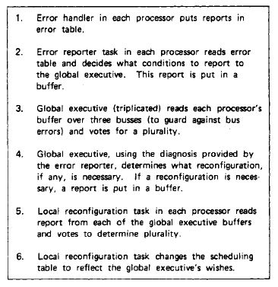
The local-global communication tasks
Local-Global communication tasks consist of reconfiguration task and error reporting task

Slide 23
The global executive task
Executed as critical task
Analyzes error reports, diagnoses errors
Determines failed processor, reccomend reconfiguration
List of processors reccomended to be reconfigured out of the system is broadcast to reconfiguration task

Slide 24
The local executive
Collection of routines
Error handler
Invoked by voter in case of fault detection
Updates error table
Scheduler
Schedule execution tasks
Use predefined iteration rate
Define sequence of time frames
Whereas execution must occur within a frame, it could be any time during that frame
Scheduler invoked by timer interrupt or completion of a task
Tasks may be preempted by clock (in order to run task with higher priority)

Slide 25
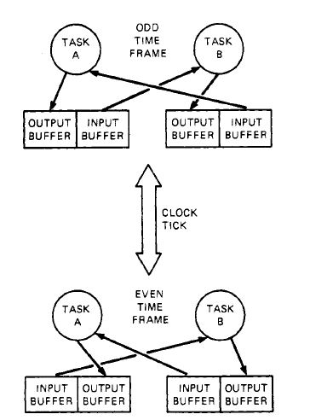
The local executive
Buffer interface routines
Double buffering: input buffer contains value from last iteration that will be used as input to task
In next frame buffers are switched
Voter routine
Invoked by a task to get inputs for its current iteration
Voter uses table of reconfiguration task to determine wich buffer contains copies of the output to be voted on
If disagreement, invoke error reporter

Slide 26
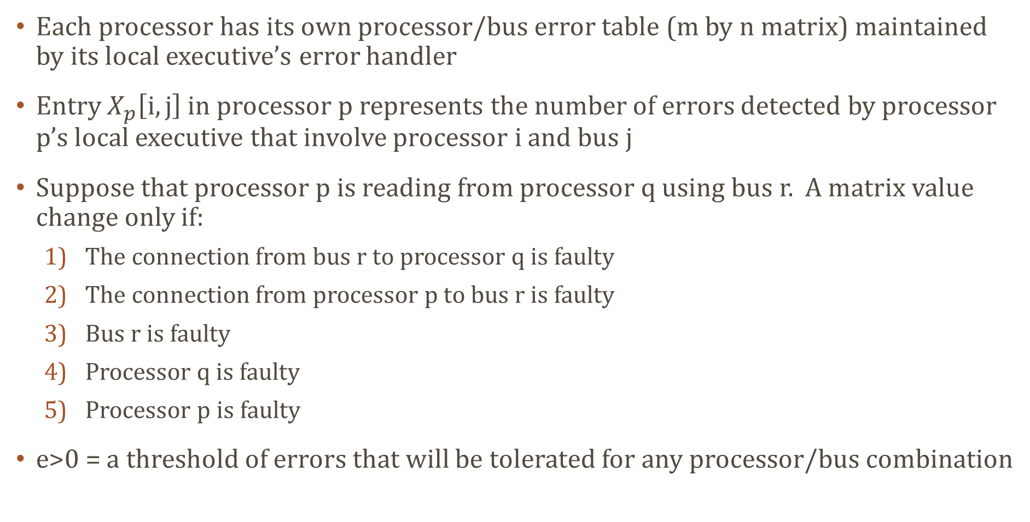
Fault detection
Each processor has its own processor/bus error table (m by n matrix) maintained by its local executive’s error handler
Entry $X_{p}\left[i,j\right]$ in processor p represents the number of errors detected by processor p’s local executive that involve processor i and bus j
Suppose that processor p is reading from processor q using bus r. A matrix value change only if:
The connection from bus r to processor q is faulty
The connection from processor p to bus r is faulty
Bus r is faulty
Processor q is faulty
Processor p is faulty
e>0 = a threshold of errors that will be tolerated for any processor/bus combination

Slide 27
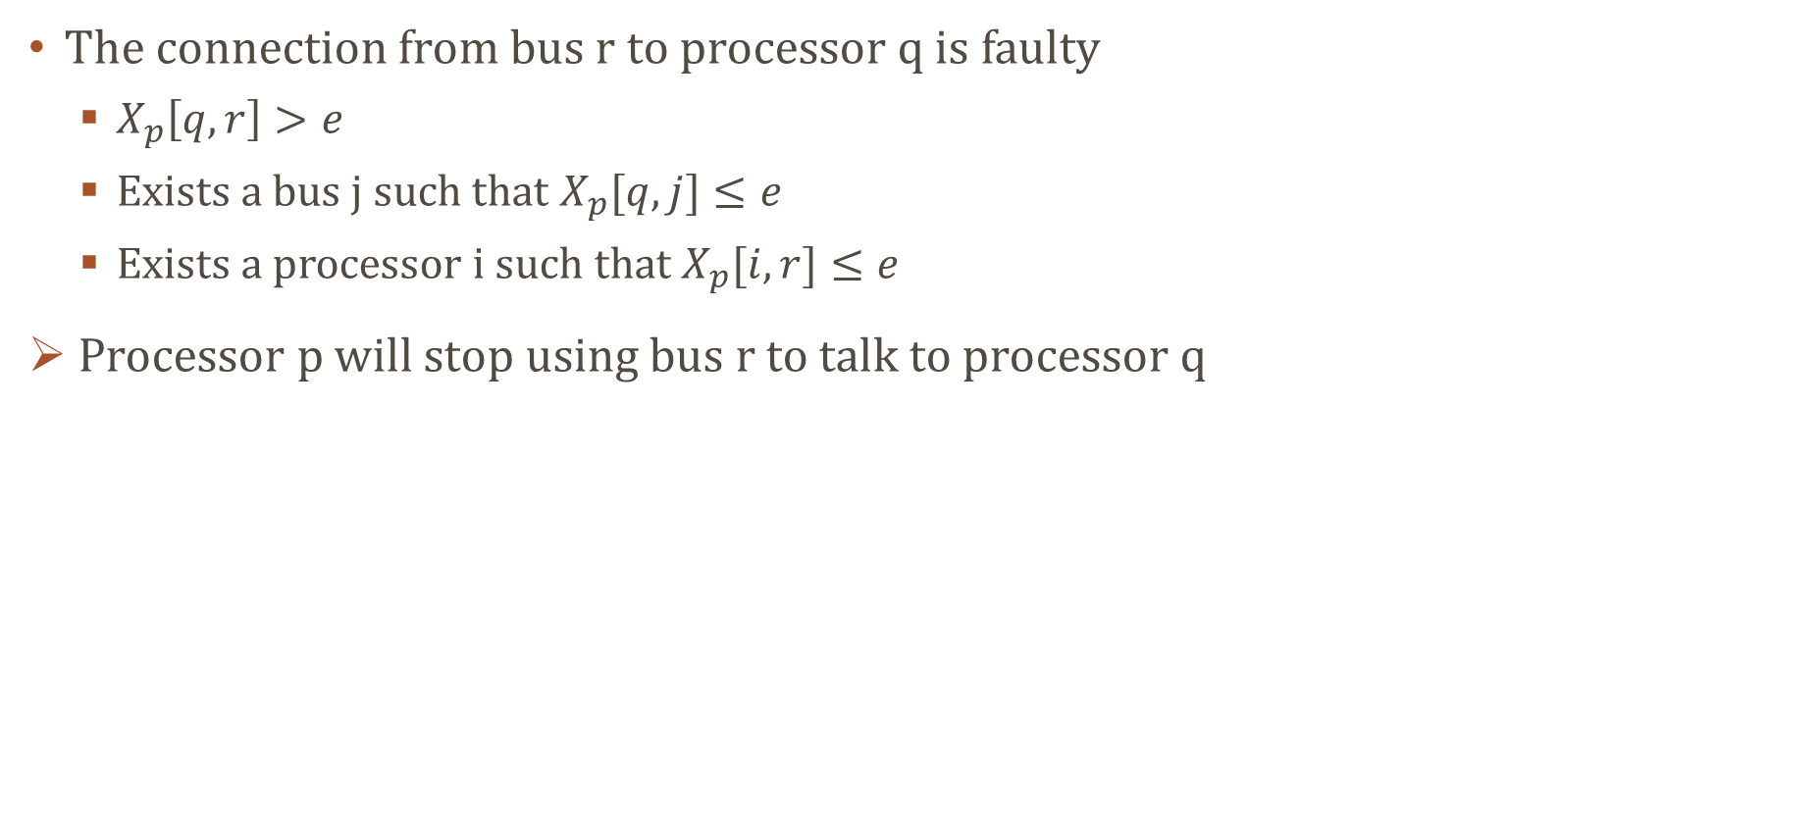
Fault detection
The connection from bus r to processor q is faulty
$X_{p}\left[q,r\right]>e$
Exists a bus j such that $X_{p}[q,j]≤e$
Exists a processor i such that $X_{p}[i,r]≤e$
Processor p will stop using bus r to talk to processor q

Slide 28
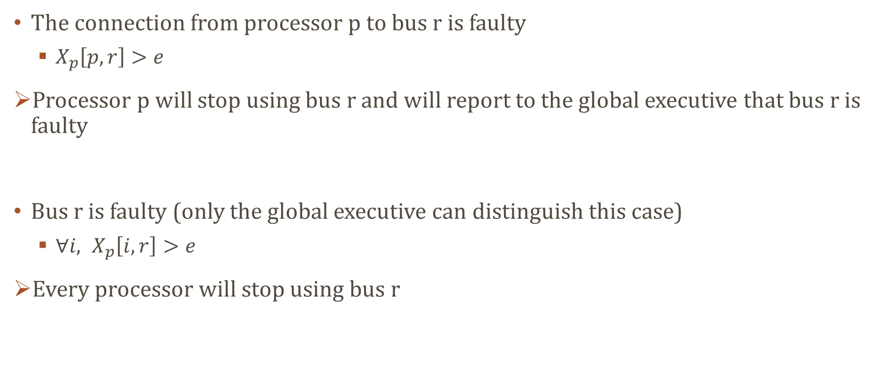
Fault detection
The connection from processor p to bus r is faulty
$X_{p}\left[p,r\right]>e$
Processor p will stop using bus r and will report to the global executive that bus r is faulty
Bus r is faulty (only the global executive can distinguish this case)
$∀i, X_{p}\left[i,r\right]>e$
Every processor will stop using bus r

Slide 29
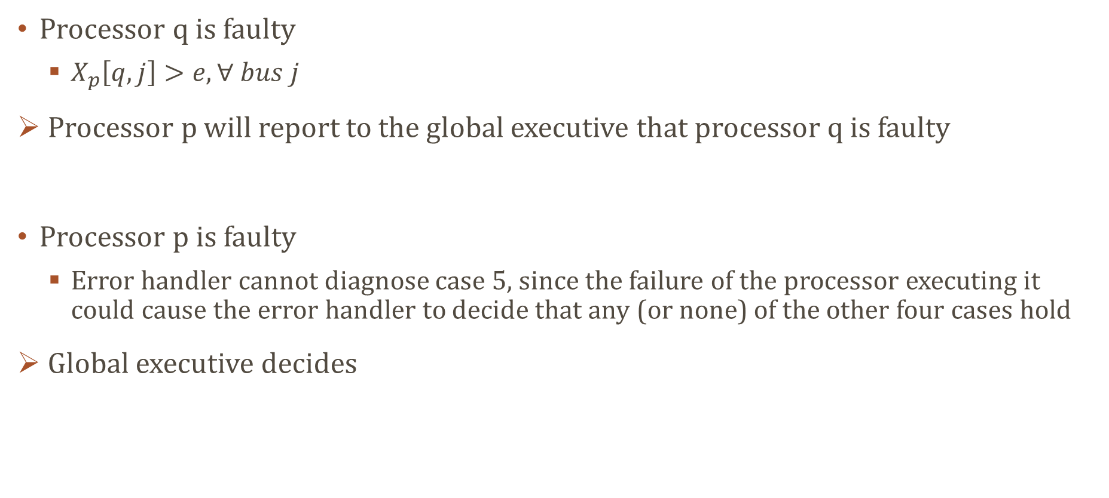
Fault detection
Processor q is faulty
$X_{p}\left[q,j\right]>e, ∀ bus j$
Processor p will report to the global executive that processor q is faulty
Processor p is faulty
Error handler cannot diagnose case 5, since the failure of the processor executing it could cause the error handler to decide that any (or none) of the other four cases hold
Global executive decides

Slide 30
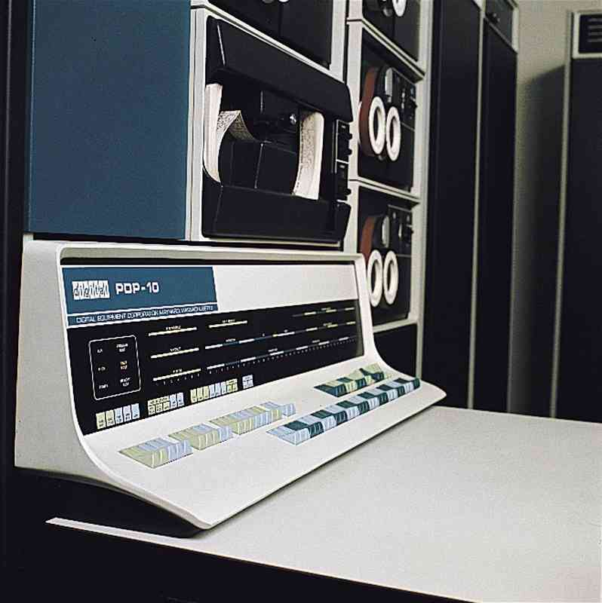
The simulator
SIFT system coded in Pascal
Avionics computer not available
Executive is being debugged on an available general purpose computer (DEC PDP-10)
A simulator has been constructed
The simulator uses five asynchronous processes, each running a SIFT executive and a «toy» set of application tasks.
Faults are injected, either at the processor or the bus levels, and a visual display of the system’s behavior is provided

Slide 31
future works
Proof of correctness
Operating system model
Program model
Real testing
When avionics computer will be available

Slide 32
conclusions
SIFT is an attempt to use modern methods of computer design and verification to achieve fault-tolerant behavior for real-time, critical control systems.
Using standard, mass produced components helps to attain high reliability
Replication of standard components to detect and analyze errors and to dynamically reconfigure the system bypassing faulty units
Pecial hardware is needed only to isolate the units from one another
Using software to achieve fault-tolerance, SIFT allows considerable flexibility
This design has been oriented toward the needs of commercial air transports but the basic architectural approach has a wide applicability to critical real-time systems.

